Slide 1
Web Services

Slide 2
SOA
A service-oriented architecture (SOA) is an architectural pattern in computer software design in which application components provide services to other components via a communications protocol, typically over a network. The principles of service-orientation are independent of any vendor, product or technology.

Slide 3
Tenets of SOA
Boundaries are explicit
Services are autonomous
Services shares Schema and Contracts , not class
Service compatibility is based policies.

Slide 4
Communication diagram
1.Client requests for metadata.
2.Service replied with meta data.
3.Client request for a service .(actual request)
4. Service sent the response.(actual response)
2
Client
4
service
3
1

Slide 5
Existing Distributed technologies
Web services
MSMQ
.Net Remoting
WSE
Enterprise Services

Slide 6
Web Service
Web services are open standard (XML, SOAP, HTTP etc.) based Web applications that interact with other web applications for the purpose of exchanging data.
Web Services which are rely on web standards and protocol.
Supports interoperability and cross the firewalls easily.
API present in System.Web.Services

Slide 7
MSMQ
Asynchronous based communication through message transfer.
Follows fire and forget approach.
Provides reliability.
API present in System.Messaging

Slide 8
WSE
Extension to Web services.
Additional capabilities like
Security
More reliable messaging.
Transactions
Provides above in open way
Provides a standard infrastructure for providing next generation web services.

Slide 9
Enterprise services
COM+ is a combination of COM,DCOM,MTS and MSMQ
Layer on top of COM+
Provides necessary service infrastructure to .Net Assemblies
API present in System.EnterpriseServices

Slide 10
.NET Remoting
Built using :
  A remotable objet which I available across AppDomains, Processes or different machines.
  A host applications to listen for the request for that object.
  A client application that makes requests for the request.

Slide 11
What are Webservices?
A web service is any piece of software that makes itself available over the internet and uses a standardized XML messaging system. XML is used to encode all communications to a web service. For example, a client invokes a web service by sending an XML message, then waits for a corresponding XML response. As all communication is in XML, web services are not tied to any one operating system or programming language--Java can talk with Perl; Windows applications can talk with Unix applications.

Slide 12
How Does a Web Service Work?
A web service enables communication among various applications by using open standards such as HTML, XML, WSDL, and SOAP. A web service takes the help of:
  XML to tag the data
  SOAP to transfer a message
  WSDL to describe the availability of service.

Slide 13
Why Webservices ?
Interoperability
  Web services allow various applications to talk to each other and share data and services among themselves. Other applications can also use the web services. For example, a VB or .NET application can talk to Java web services and vice versa. Web services are used to make the application platform and technology independent.
Standardized Protocol
  Web services use standardized industry standard protocol for the communication. All the four layers (Service Transport, XML Messaging, Service Description, and Service Discovery layers) use well-defined protocols in the web services protocol stack. This standardization of protocol stack gives the business many advantages such as a wide range of choices, reduction in the cost due to competition, and increase in the quality.
Low Cost of Communication
  Web services use SOAP over HTTP protocol, so you can use your existing low-cost internet for implementing web services. This solution is much less costly compared to proprietary solutions like EDI/B2B. Besides SOAP over HTTP, web services can also be implemented on other reliable transport mechanisms like FTP.

Slide 14
Components of Web Services
The basic web services platform is XML + HTTP. All the standard web services work using the following components
  SOAP (Simple Object Access Protocol)
  UDDI (Universal Description, Discovery and Integration)
  WSDL (Web Services Description Language)

Slide 15
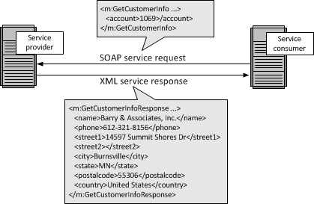
SOAP
SOAP was originally part of the specification that included the Web Services Description Language (WSDL) and Universal Description, Discovery, and Integration (UDDI). It is used now without WSDL and UDDI. Instead of the discovery process described in the History of the Web Services Specification section below, SOAP messages are hard-coded or generated without the use of a repository. The interaction is illustrated in the figure below.

Slide 16
UDDI
UDDI is an XML-based standard for describing, publishing, and finding web services.
UDDI stands for Universal Description, Discovery, and Integration.
UDDI is a specification for a distributed registry of web services.
UDDI is platform independent, open framework.
UDDI can communicate via SOAP, CORBA, and Java RMI Protocol.
UDDI uses WSDL to describe interfaces to web services.
UDDI is seen with SOAP and WSDL as one of the three foundation standards of web services.
UDDI is an open industry initiative enabling businesses to discover each other and define how they interact over the Internet.

Slide 17
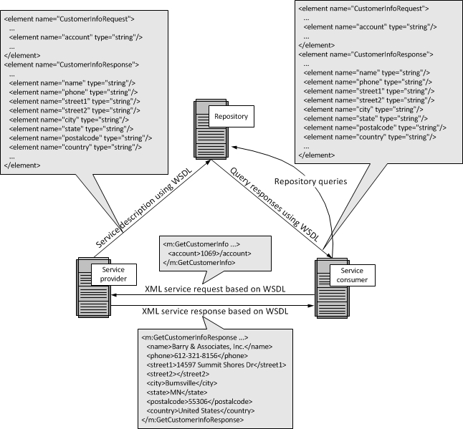

Slide 18
WSDL
WSDL is an XML-based language for describing web services and how to access them.
WSDL stands for Web Services Description Language.
WSDL was developed jointly by Microsoft and IBM.
WSDL is an XML based protocol for information exchange in decentralized and distributed environments.
WSDL is the standard format for describing a web service.
WSDL definition describes how to access a web service and what operations it will perform.
WSDL is a language for describing how to interface with XML-based services.
WSDL is an integral part of UDDI, an XML-based worldwide business registry.
WSDL is the language that UDDI uses.
WSDL is pronounced as 'wiz-dull' and spelled out as 'W-S-D-L'.

Slide 19
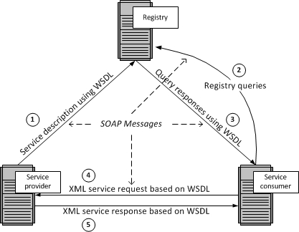

Slide 20
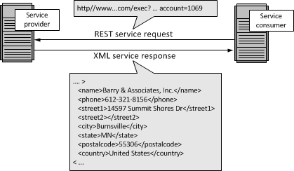
Representation State Transfer (REST)
Representation State Transfer (REST) appeals to developers because it has a simpler style that makes it easier to use than SOAP. It also less verbose so that less volume is sent when communicating. The interaction is illustrated in the figure below

Slide 21
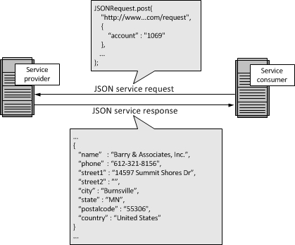
JavaScript Object Notation (JSON)
While both SOAP and REST use XML for interchange, JavaScript Object Notation (JSON) uses a subset of JavaScript. This is illustrated in the figure below

